Slide 1



Correlated Decoding on Elongated Compass Codes
Arianna Meinking
Julie Campos
(Compass Code Expert)
Kenneth Brown
(Advisor)

Slide 2
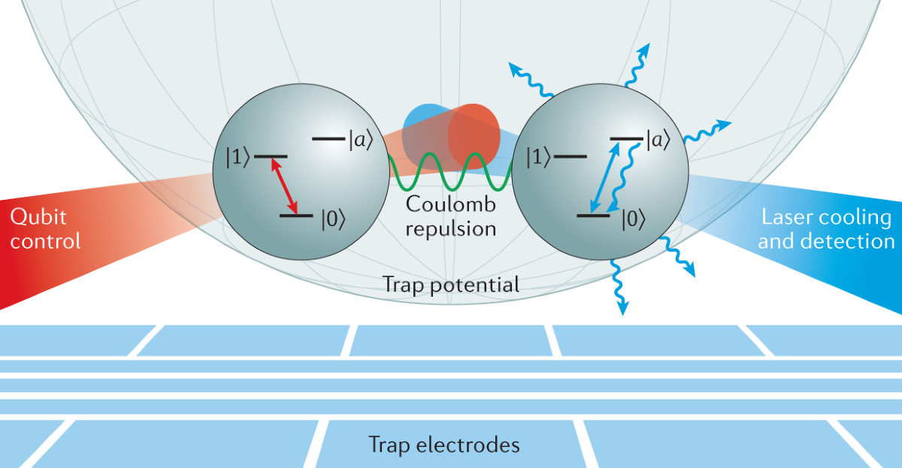
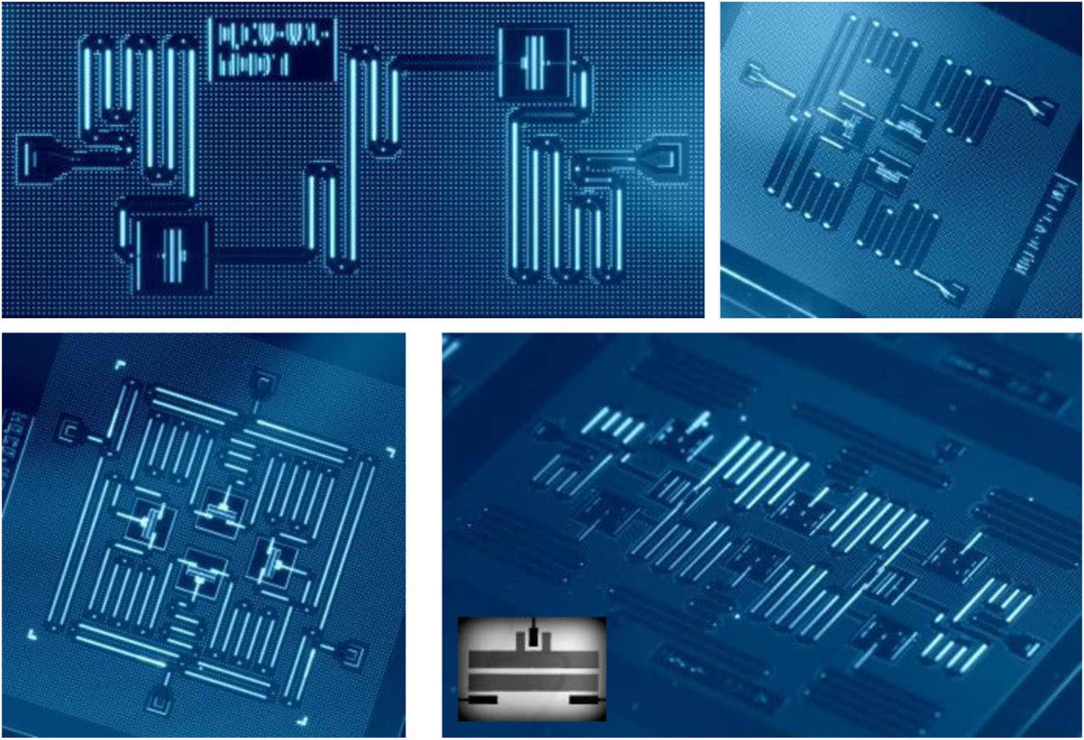
Bias Noise is Common
(L) Brown, K.R., Chiaverini, J., Sage, J.M. et al. Nat Rev Mater 6, 892–905 (2021)
(R) J.M. Gambetta, J.M Chow, M. Steffan, npj Quantum Inf 3, 2 (2017)
Notes:
Codesign error correction!
- See dephasing errors more commonly

Slide 3
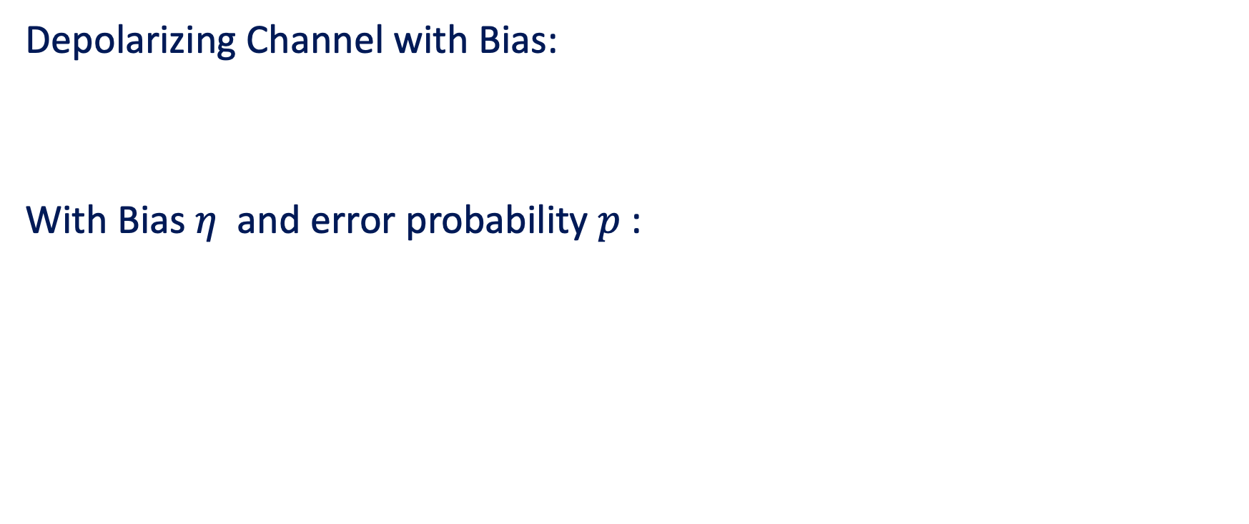
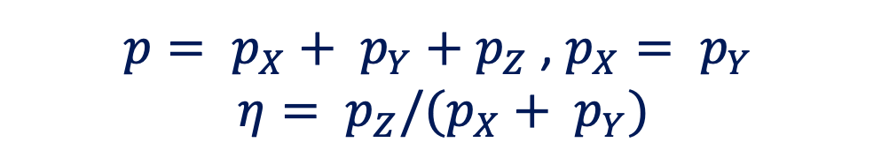
Biased Noise Model
Depolarizing Channel with Bias:
With Bias $η$ and error probability $p$:
$ℇ\left(ρ\right)=\left(1−p\right)ρ+ p_{X}XρX$ $+ p_{Y}YρY$ $+ p_{Z}ZρZ$
$p= p_{X}+ p_{Y}+p_{Z}$ , $p_{X}= p_{Y}$
$$η= p_{Z}/(p_{X}+ p_{Y})$$
M. Li, D. Miller, M. Newman, et al. Phys Rev X 9, 021041 (2019)
Notes:
We model this using a standard depolarizing channel, with added noise bias. To reflect the prevalence of Z errors, the noise bias eta is defined as the ratio of Z errors to the X and Y errors.

Slide 4
Codes that Perform Well at High Bias
XZZX surface code
Elongated Compass codes
Customized qLDPC codes
More …
¹Bonilla Ataides, J.P., Tuckett, D.K., Bartlett, S.D. et al. Nat Commun 12, 2172 (2021)
² J. Campos, K.R. Brown, arXiv:2412.03808 (2024)
³ J. Roffe, L.Z. Kohen, A.O.Quintavalle, et. al. Quantum 7, 1005 (2023)

Slide 5
Codes that Perform Well at High Bias
XZZX surface code
Elongated Compass codes
Customized qLDPC codes
More …
¹Bonilla Ataides, J.P., Tuckett, D.K., Bartlett, S.D. et al. Nat Commun 12, 2172 (2021)
² J. Campos, K.R. Brown, arXiv:2412.03808 (2024)
³ J. Roffe, L.Z. Kohen, A.O.Quintavalle, et. al. Quantum 7, 1005 (2023)

Slide 6
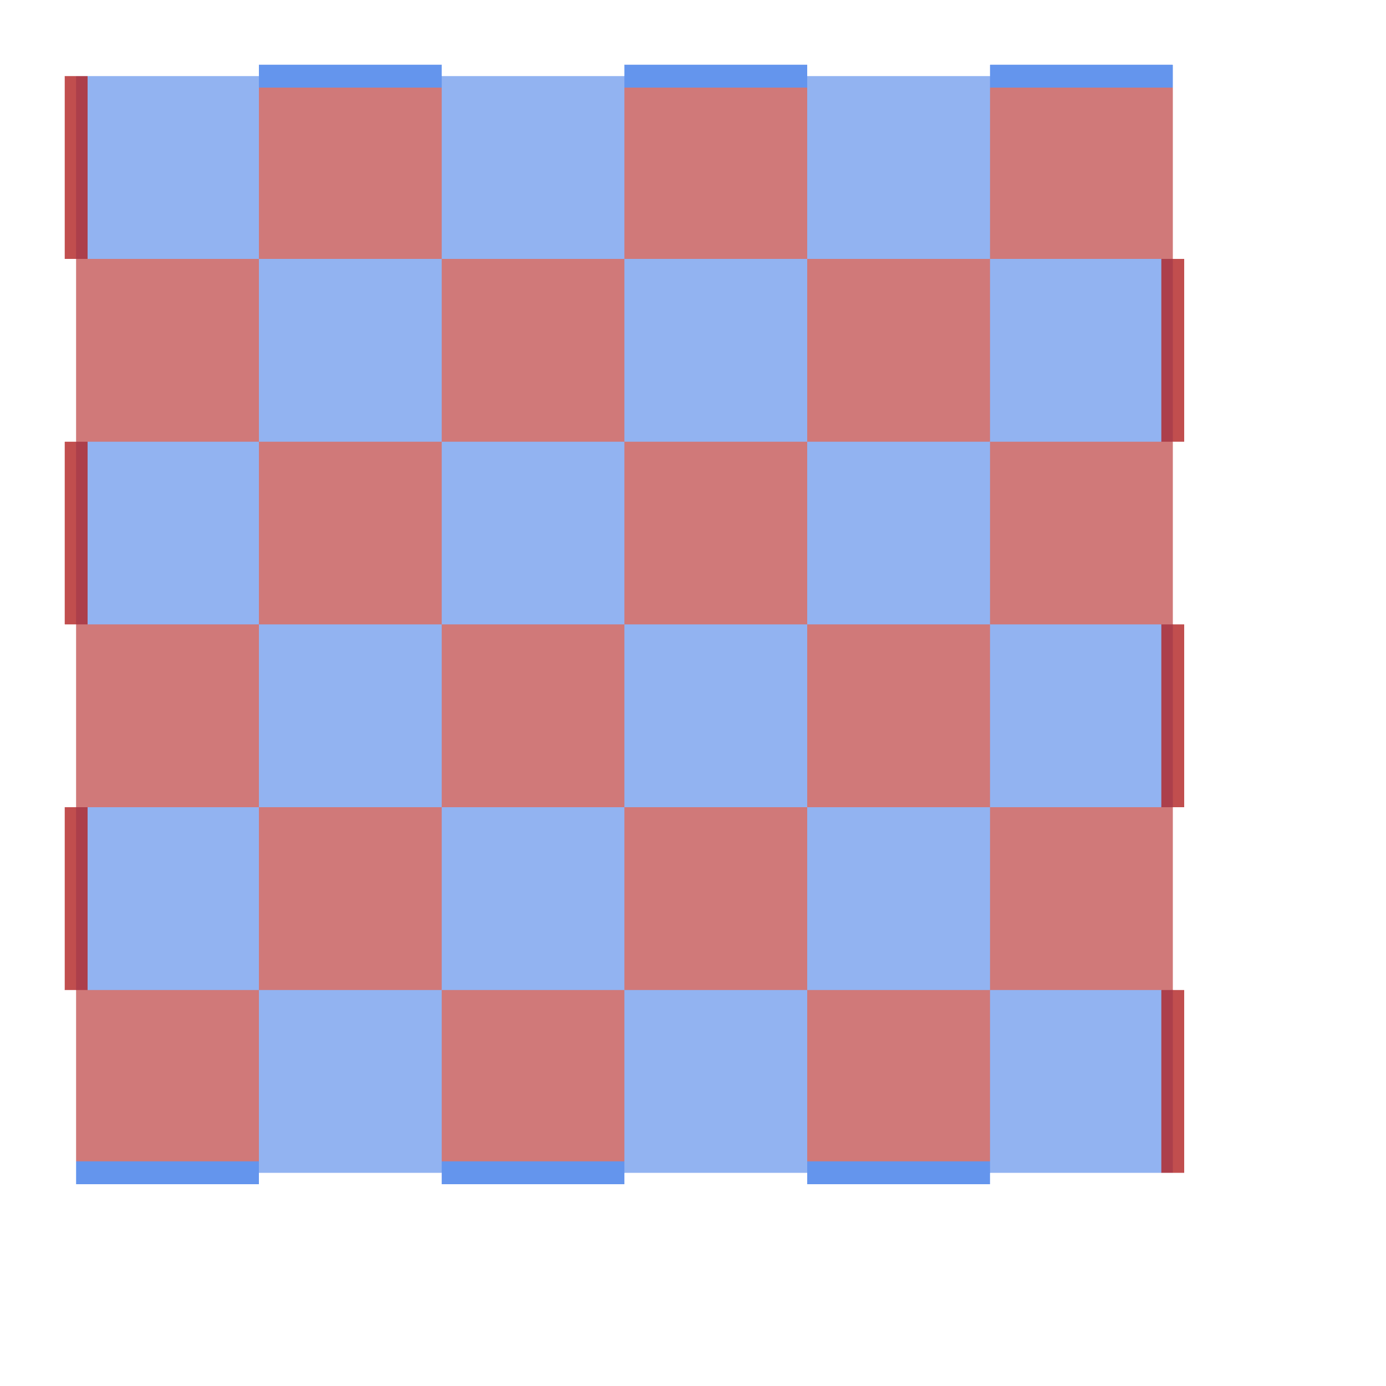
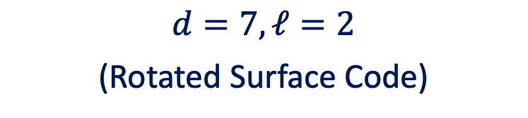
(1) Elongated Compass Codes
$$d=7, ℓ=2$$
(Rotated Surface Code)
Notes:
So first, we can use compass codes to aid us with noise bias issues. Elongated compass codes are created by ‘stretching’ out the Z stabilizers on the rotated surface code. Here is what that will look like, with each boundary consisting of two qubit plaquettes. The red are the Z stabilizers, the blue are the X stabilizers.
What are compass codes
Why are they good for high noise biases
Why do they need to be improved

Slide 7
(1) Elongated Compass Codes
X
Z
$$d=7, ℓ=2$$
(Rotated Surface Code)
Notes:
So first, we can use compass codes to aid us with noise bias issues. Elongated compass codes are created by ‘stretching’ out the Z stabilizers on the rotated surface code. Here is what that will look like, with each boundary consisting of two qubit plaquettes. The red are the Z stabilizers, the blue are the X stabilizers.
What are compass codes
Why are they good for high noise biases
Why do they need to be improved

Slide 8
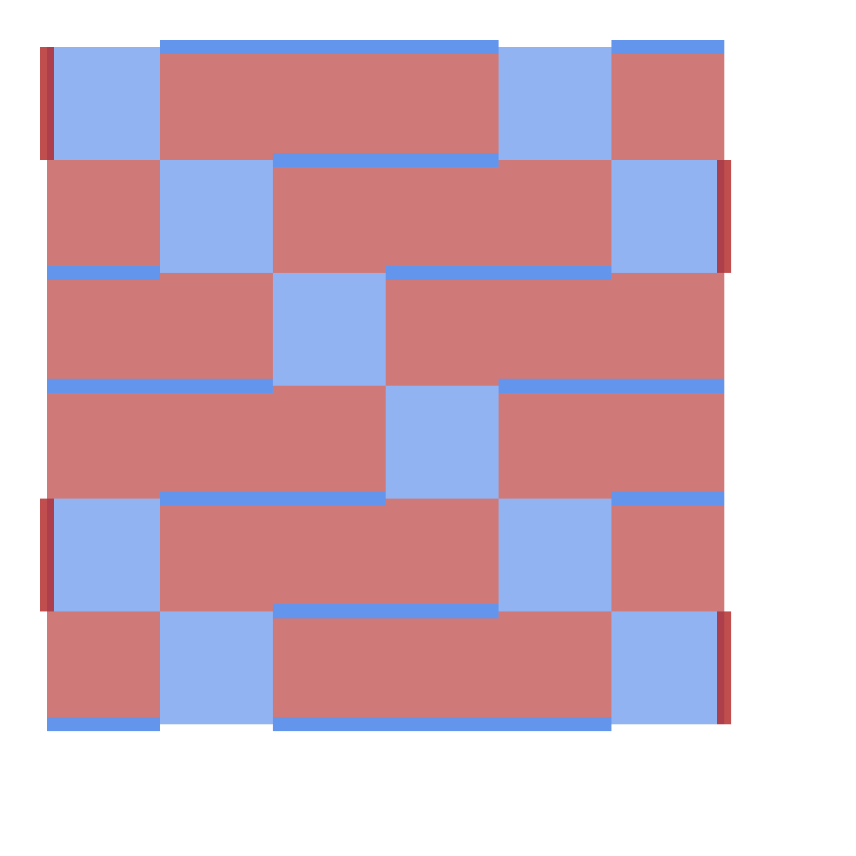

(1) Elongated Compass Codes
X
Z
$$d=7, ℓ=2$$
(Rotated Surface Code)
$$d=7, ℓ=4$$
Notes:
So first, we can use compass codes to aid us with noise bias issues. Elongated compass codes are created by ‘stretching’ out the Z stabilizers on the rotated surface code. Here is what that will look like, with each boundary consisting of two qubit plaquettes. The red are the Z stabilizers, the blue are the X stabilizers. The tiling to the right is an example of elongation parameter l=4 on a distance 7 compass code. The borders of the compass code are partially what make it so useful – as are the low weight X stabilizers. The large Z stabilizers mean that for a given error, it is more difficult to diagnose a X error. Between the high weight Z stabilizers are a series of weight 2 X stabilizers. These make it easier to decode Z errors. We may then theorize that at larger noise biases, larger elongation parameters will have higher thresholds.
What are compass codes
Why are they good for high noise biases
Why do they need to be improved

Slide 9
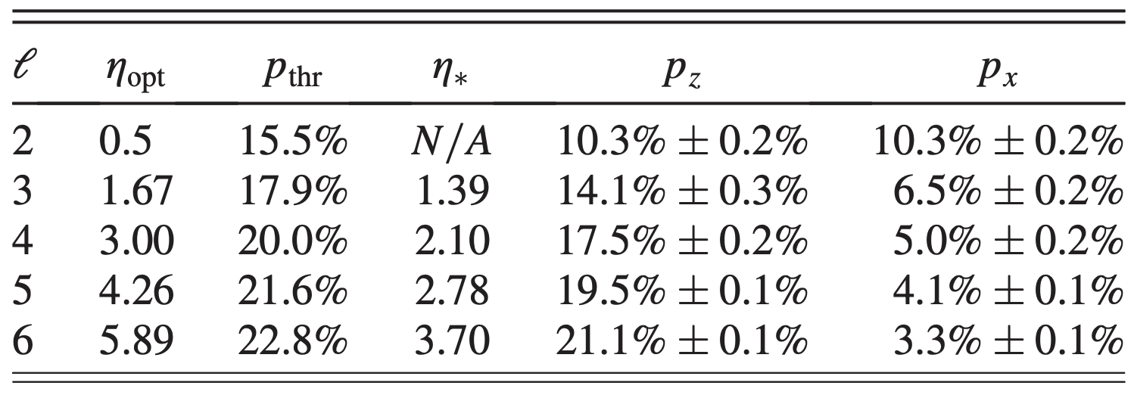
(1) Elongated Compass Codes
X
Z
$$d=7, ℓ=4$$
M. Li, D. Miller, M. Newman, et al. Phys Rev X 9, 021041 (2019)
Notes:
So first, we can use compass codes to aid us with noise bias issues. Elongated compass codes are created by ‘stretching’ out the Z stabilizers on the rotated surface code. Here is what that will look like, with each boundary consisting of two qubit plaquettes. The red are the Z stabilizers, the blue are the X stabilizers. The tiling to the right is an example of elongation parameter l=4 on a distance 7 compass code. The borders of the compass code are partially what make it so useful – as are the low weight X stabilizers. The large Z stabilizers mean that for a given error, it is more difficult to diagnose a X error. Between the high weight Z stabilizers are a series of weight 2 X stabilizers. These make it easier to decode Z errors. We may then theorize that at larger noise biases, larger elongation parameters will have higher thresholds.
Indeed, this is the case. As was previously investigated in research by Brown lab, my colleagues found that there is an optimal noise bias for the maximum total threshold. In this paper, we also found that the thresholds for the X and Z errors behave proptionally – the higher the elongation, the better Z decoding. The tradeoff is that the decoding gets worse for X errors.
What are compass codes
Why are they good for high noise biases
Why do they need to be improved

Slide 10
(1) Elongated Compass Codes
X
Z
$$d=7, ℓ=4$$
M. Li, D. Miller, M. Newman, et al. Phys Rev X 9, 021041 (2019)
Notes:
So first, we can use compass codes to aid us with noise bias issues. Elongated compass codes are created by ‘stretching’ out the Z stabilizers on the rotated surface code. Here is what that will look like, with each boundary consisting of two qubit plaquettes. The red are the Z stabilizers, the blue are the X stabilizers. The tiling to the right is an example of elongation parameter l=4 on a distance 7 compass code. The borders of the compass code are partially what make it so useful – as are the low weight X stabilizers. The large Z stabilizers mean that for a given error, it is more difficult to diagnose a X error. Between the high weight Z stabilizers are a series of weight 2 X stabilizers. These make it easier to decode Z errors. We may then theorize that at larger noise biases, larger elongation parameters will have higher thresholds.
Indeed, this is the case. As was previously investigated in research by Brown lab, my colleagues found that there is an optimal noise bias for the maximum total threshold. In this paper, we also found that the thresholds for the X and Z errors behave proportionally – the higher the elongation, the better Z decoding. The tradeoff is that the decoding gets worse for X errors. These compass codes look like a great place to start – they improve upon the standard surface code for some noise bias, but we would really like to extend this to beyond lower biases – real experiments see biases with eta = 100
Why do they need to be improved

Slide 11
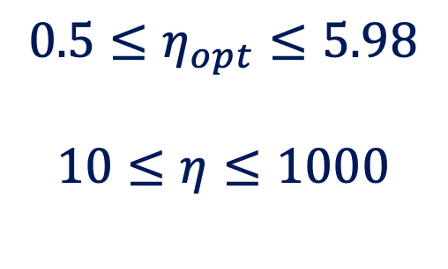
(1) Elongated Compass Codes
X
$$0.5≤η_{opt}≤5.98$$
$$10≤η≤1000$$
Z
$$d=7, ℓ=4$$
J.P. Bonilla Ataides, D.K Tuckett, S.D. Bartlett, et al. Nat Commun 12, 2172 (2021)
Notes:
So first, we can use compass codes to aid us with noise bias issues. Elongated compass codes are created by ‘stretching’ out the Z stabilizers on the rotated surface code. Here is what that will look like, with each boundary consisting of two qubit plaquettes. The red are the Z stabilizers, the blue are the X stabilizers. The tiling to the right is an example of elongation parameter l=4 on a distance 7 compass code. The borders of the compass code are partially what make it so useful – as are the low weight X stabilizers. The large Z stabilizers mean that for a given error, it is more difficult to diagnose a X error. Between the high weight Z stabilizers are a series of weight 2 X stabilizers. These make it easier to decode Z errors. We may then theorize that at larger noise biases, larger elongation parameters will have higher thresholds.
Indeed, this is the case. As was previously investigated in research by Brown lab, my colleagues found that there is an optimal noise bias for the maximum total threshold. In this paper, we also found that the thresholds for the X and Z errors behave proportionally – the higher the elongation, the better Z decoding. The tradeoff is that the decoding gets worse for X errors. These compass codes look like a great place to start – they improve upon the standard surface code for some noise bias, but we would really like to extend this to beyond lower biases – real experiments see biases with eta = 1000, so we may need to do more.

Slide 12
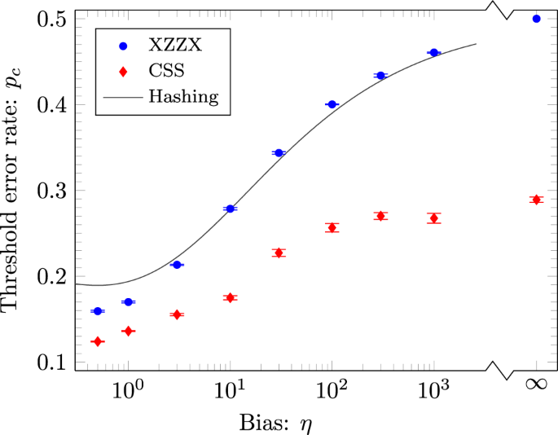
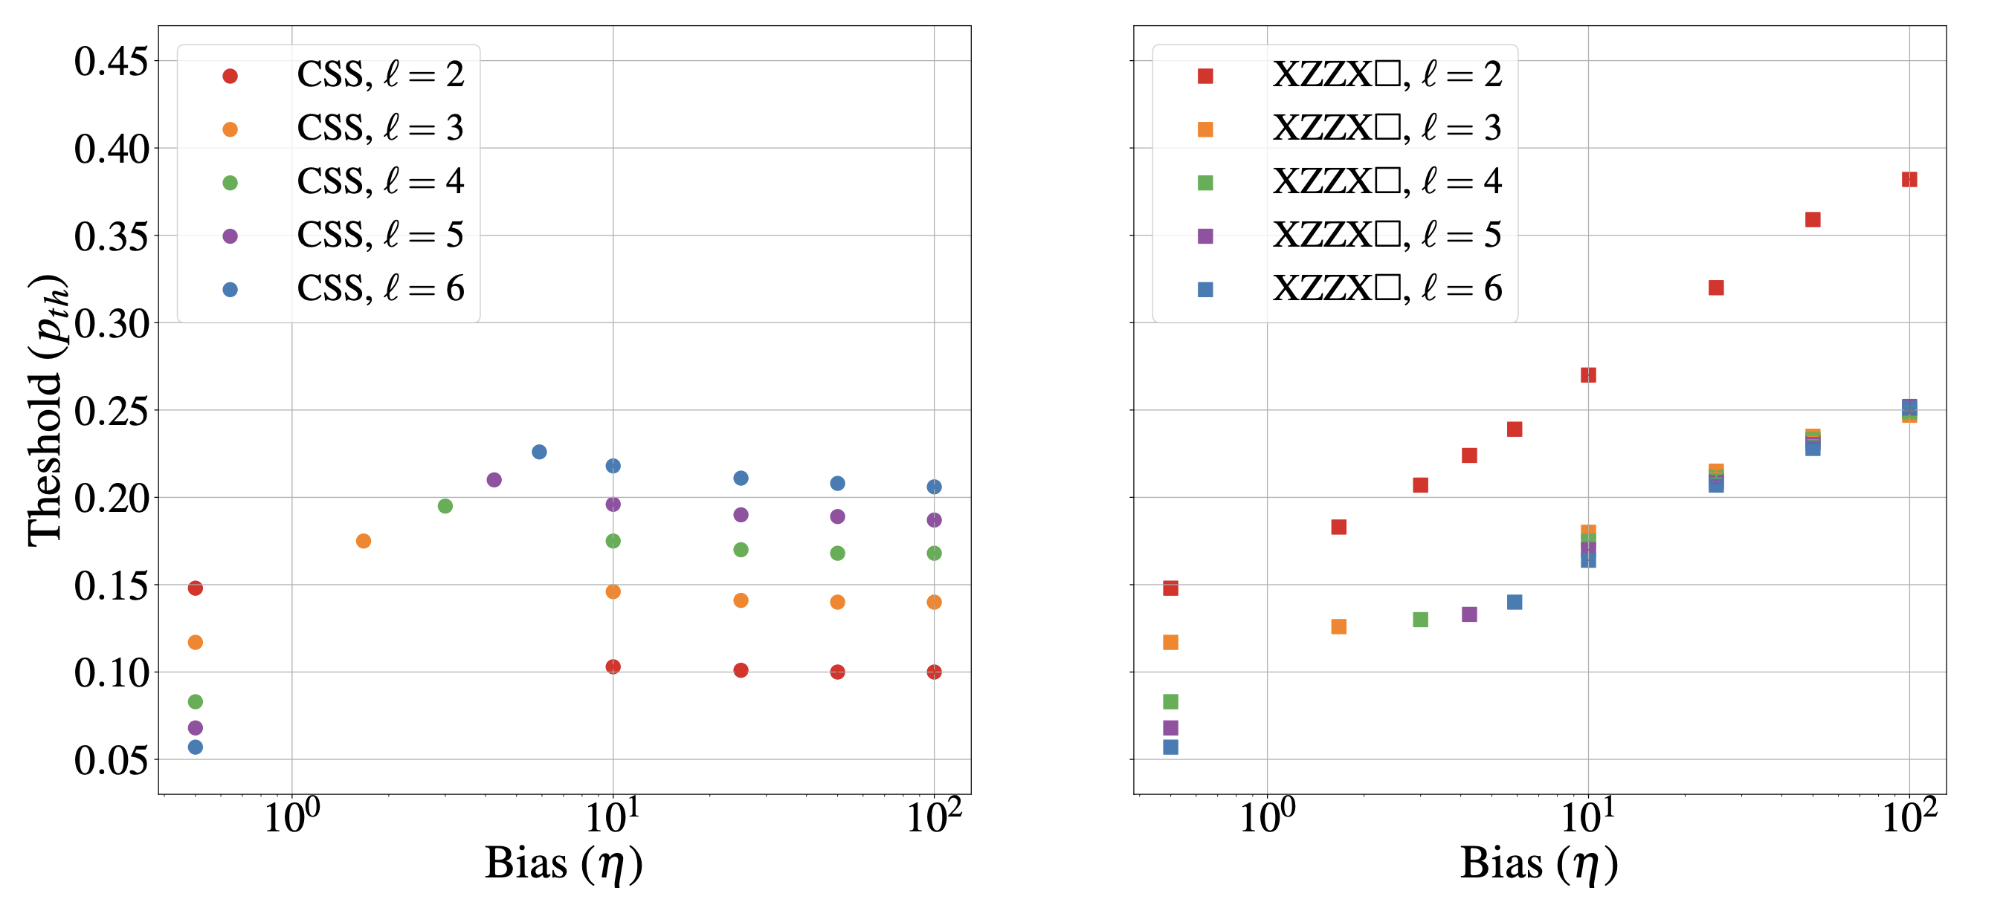
Decoders for high bias
Maximum Likelihood Decoding: XZZX
MWPM: Elongated Compass Codes
(L) Bonilla Ataides, J.P., Tuckett, D.K., Bartlett, S.D. et al. Nat Commun 12, 2172 (2021)
(R) J. Campos, K.R. Brown, arXiv:2412.03808 (2024)
Notes:
Maybe try to find paper that says correlated decoding works better with weird plaquettes
Correlated decoder will be good for elongated surface code with bias???
Don’t get as high of threshold in MWPM (18 vs 15% at no bias) because of Clifford deformations

Slide 13
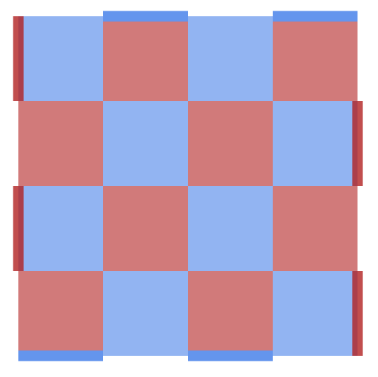
(2) Correlated Decoding
X
Make X and Z decoder matching graphs with MWPM
Correct X errors
Label edges with errors as ‘erased’, remove from Z matching graphs
Correct Z errors with new matching graphs
Z
X
Z
Y
N Delfosse, J.P. Tillich, arXiv:1401.6975 (2014)
Notes:
In 2014, Delfosse and Tillich developed a way to use correlations between X and Z errors to change the standard depolarizing channel to an erasure channel. They describe the method in the paper here, but essentially, one takes a syndrome on the toric code(a), uses it to identify and correct X errors, label those errors as erased edges, and remove them from the match graph for Z errors. For an erasure channel, knowing that an X error has occurred on an edge makes
Works well on toric code
Could work with the compass codes to ‘extend’ their thresholds at higher noise bias
What is the advantage of correlated decoding?
Y errors have correlation between X and Z
Correlated decoding takes advantage of these correlations by considering the Y decoding first

Slide 14
(2) Correlated Decoding
X
Make X and Z decoder matching graphs with MWPM
Correct X errors
Label edges with errors as ‘erased’, remove from Z matching graphs
Correct Z errors with new matching graphs
Z
X
Z
Y
N Delfosse, J.P. Tillich, arXiv:1401.6975 (2014)
Notes:
In 2014, Delfosse and Tillich developed a way to use correlations between X and Z errors to change the standard depolarizing channel to an erasure channel. They describe the method in the paper here, but essentially, one takes a syndrome on the toric code(a), uses it to identify and correct X errors, label those errors as erased edges, and remove them from the match graph for Z errors. For an erasure channel, knowing that an X error has occurred on an edge makes
Works well on toric code
Could work with the compass codes to ‘extend’ their thresholds at higher noise bias

Slide 15
(2) Correlated Decoding
X
Make X and Z decoder matching graphs with MWPM
Correct X errors
Label edges with errors as ‘erased’, remove from Z matching graphs
Correct Z errors with new matching graphs
Z
X
Z
Y
N Delfosse, J.P. Tillich, arXiv:1401.6975 (2014)
Notes:
In 2014, Delfosse and Tillich developed a way to use correlations between X and Z errors to change the standard depolarizing channel to an erasure channel. They describe the method in the paper here, but essentially, one takes a syndrome on the toric code(a), uses it to identify and correct X errors, label those errors as erased edges, and remove them from the match graph for Z errors. For an erasure channel, knowing that an X error has occurred on an edge makes
Works well on toric code
Could work with the compass codes to ‘extend’ their thresholds at higher noise bias

Slide 16
(2) Correlated Decoding
X
Make X and Z decoder matching graphs with MWPM
Correct X errors
Label edges with errors as ‘erased’, remove from Z matching graphs
Correct Z errors with new matching graphs
Z
X
Z
Y
N Delfosse, J.P. Tillich, arXiv:1401.6975 (2014)
Notes:
In 2014, Delfosse and Tillich developed a way to use correlations between X and Z errors to change the standard depolarizing channel to an erasure channel. They describe the method in the paper here, but essentially, one takes a syndrome on the toric code(a), uses it to identify and correct X errors, label those errors as erased edges, and remove them from the match graph for Z errors. For an erasure channel, knowing that an X error has occurred on an edge makes
Works well on toric code
Could work with the compass codes to ‘extend’ their thresholds at higher noise bias
Set to zero using log likehood

Slide 17
(2) Correlated Decoding
X
Make X and Z decoder matching graphs with MWPM
Correct X errors
Label edges with errors as ‘erased’, remove from Z matching graphs
Correct Z errors with new matching graphs
Z
X
Z
Y
N Delfosse, J.P. Tillich, arXiv:1401.6975 (2014)
Notes:
In 2014, Delfosse and Tillich developed a way to use correlations between X and Z errors to change the standard depolarizing channel to an erasure channel. They describe the method in the paper here, but essentially, one takes a syndrome on the toric code(a), uses it to identify and correct X errors, label those errors as erased edges, and remove them from the match graph for Z errors. For an erasure channel, knowing that an X error has occurred on an edge makes
Works well on toric code
Could work with the compass codes to ‘extend’ their thresholds at higher noise bias

Slide 18
Compass code, code capacity … we have a few interesting preliminary results
Notes:
why would correlated decoding help with noise bias

Slide 19
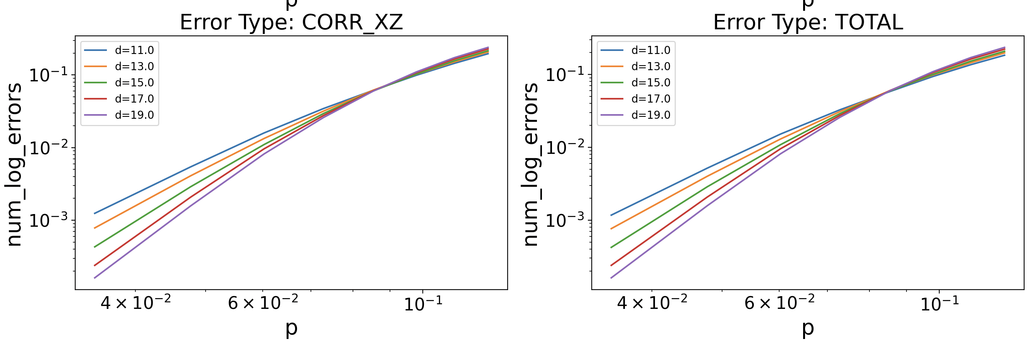
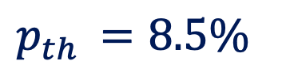

MWPM
Errors
X
Z
$p_{th }=8.5\%$
$$ℓ=4, η=0.5$$
Notes:
If we use the correlated decoder on the compass codes, we find that the threshold of the correlated decoding does much better than the regular decoding. However, at high noise bias, we don’t notice benefits. This does make some sense – at high bias, there are fewer X errors, so we lose benefits of correcting X errors and then Z errors since there is less correlated information. At low bias, there is more benefit because there are many more X errors that inform Z correction.
Pthr_corr = 23.55%, Pth = 8% (multiple crossing) l=4 eta 0.5 XZ
Pth_corr = 19.2%, pth = 12% l=3 eta 0.5 XZ
Pth_corr = 30%, pth = 21% l=6 eta 0.5 XZ
4.06 12.66
Q – do I talk about multiple crossings? The benefits of corr. Decoding are more at higher l, but that might be because of the multi-crossing weirdness

Slide 20
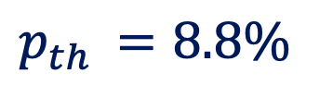
Correlated Decoding (X then Z errors)
Errors
X
Z
$p_{th }=8.8\%$
$$ℓ=4, η=0.5$$
Notes:
If we use the correlated decoder on the compass codes, we find that the threshold of the correlated decoding does much better than the regular decoding. However, at high noise bias, we don’t notice benefits. This does make some sense – at high bias, there are fewer X errors, so we lose benefits of correcting X errors and then Z errors since there is less correlated information. At low bias, there is more benefit because there are many more X errors that inform Z correction.
Pthr_corr = 23.55%, Pth = 8% (multiple crossing) l=4 eta 0.5 XZ
Pth_corr = 19.2%, pth = 12% l=3 eta 0.5 XZ
Pth_corr = 30%, pth = 21% l=6 eta 0.5 XZ
4.06 12.66
Q – do I talk about multiple crossings? The benefits of corr. Decoding are more at higher l, but that might be because of the multi-crossing weirdness

Slide 21
What if we swapped the order of decoding?

Slide 22
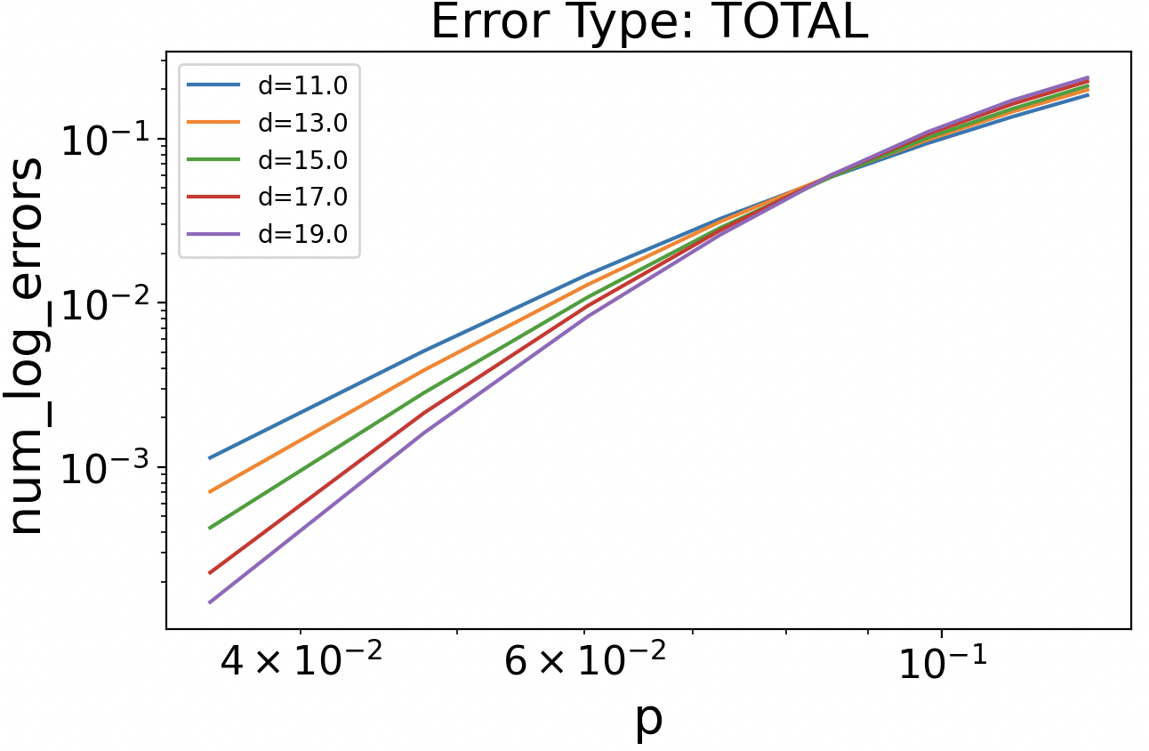
MWPM
Errors
X
Z
$p_{th }=8.5\%$
$$ℓ=4, η=0.5$$
Notes:
If we use the correlated decoder on the compass codes, we find that the threshold of the correlated decoding does much better than the regular decoding. However, at high noise bias, we don’t notice benefits. This does make some sense – at high bias, there are fewer X errors, so we lose benefits of correcting X errors and then Z errors since there is less correlated information. At low bias, there is more benefit because there are many more X errors that inform Z correction.
Pthr_corr = 23.55%, Pth = 8% (multiple crossing) l=4 eta 0.5 XZ
Pth_corr = 19.2%, pth = 12% l=3 eta 0.5 XZ
Pth_corr = 30%, pth = 21% l=6 eta 0.5 XZ
4.06 12.66
Q – do I talk about multiple crossings? The benefits of corr. Decoding are more at higher l, but that might be because of the multi-crossing weirdness

Slide 23
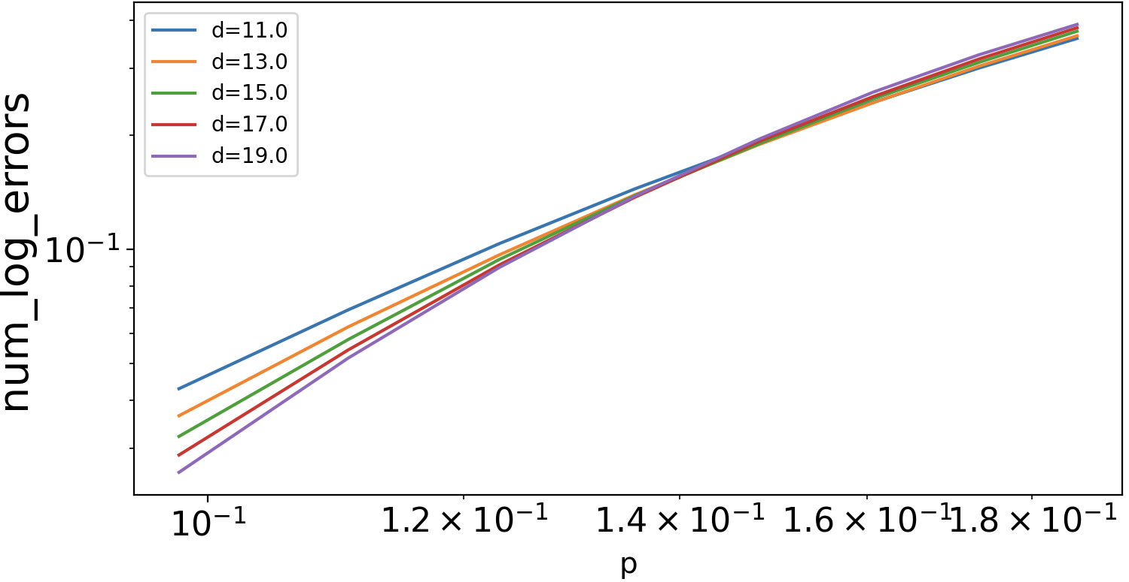
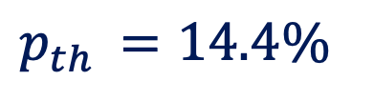
Correlated Decoding (Z then X)
Errors
X
Z
$p_{th }=14.4\%$
$$ℓ=4, η=0.5$$
Notes:
If we use the correlated decoder on the compass codes, we find that the threshold of the correlated decoding does much better than the regular decoding. However, at high noise bias, we don’t notice benefits. This does make some sense – at high bias, there are fewer X errors, so we lose benefits of correcting X errors and then Z errors since there is less correlated information. At low bias, there is more benefit because there are many more X errors that inform Z correction.
Pthr_corr = 23.55%, Pth = 8% (multiple crossing) l=4 eta 0.5 XZ
Pth_corr = 19.2%, pth = 12% l=3 eta 0.5 XZ
Pth_corr = 30%, pth = 21% l=6 eta 0.5 XZ
4.06 12.66
L = 2 – 14 regular, 16 correlated
L = 3 – 11 r, 17 correlated
L = 4 – 8 r, 14 corr
L = 5 – 6 r, 11 corr
L = 6 – 5 r, 9 corr
Q – do I talk about multiple crossings? The benefits of corr. Decoding are more at higher l, but that might be because of the multi-crossing weirdness

Slide 24
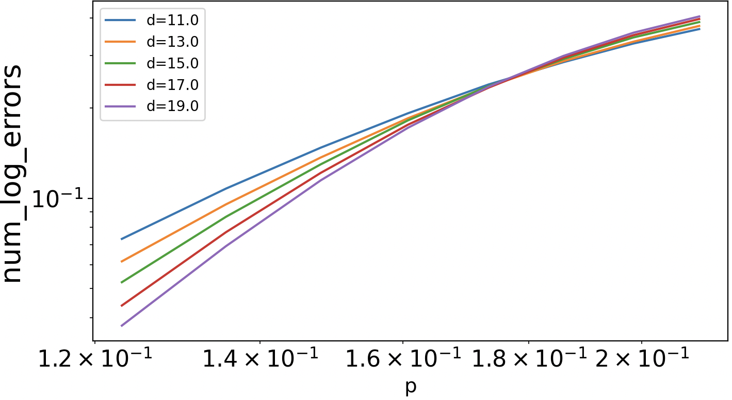
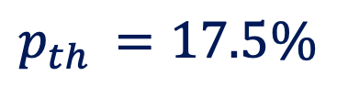

MWPM
Errors
X
Z
$p_{th }=17.5\%$
$$ℓ=4, η=10$$
Notes:
If we use the correlated decoder on the compass codes, we find that the threshold of the correlated decoding does much better than the regular decoding. However, at high noise bias, we don’t notice benefits. This does make some sense – at high bias, there are fewer X errors, so we lose benefits of correcting X errors and then Z errors since there is less correlated information. At low bias, there is more benefit because there are many more X errors that inform Z correction.
Pthr_corr = 23.55%, Pth = 8% (multiple crossing) l=4 eta 0.5 XZ
Pth_corr = 19.2%, pth = 12% l=3 eta 0.5 XZ
Pth_corr = 30%, pth = 21% l=6 eta 0.5 XZ
4.06 12.66
Q – do I talk about multiple crossings? The benefits of corr. Decoding are more at higher l, but that might be because of the multi-crossing weirdness

Slide 25

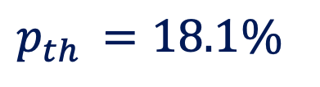
Correlated Decoding (Z then X)
Errors
X
Z
$p_{th }=18.1\%$
$$ℓ=4, η=10$$
Notes:
If we use the correlated decoder on the compass codes, we find that the threshold of the correlated decoding does much better than the regular decoding. However, at high noise bias, we don’t notice benefits. This does make some sense – at high bias, there are fewer X errors, so we lose benefits of correcting X errors and then Z errors since there is less correlated information. At low bias, there is more benefit because there are many more X errors that inform Z correction.
Pthr_corr = 23.55%, Pth = 8% (multiple crossing) l=4 eta 0.5 XZ
Pth_corr = 19.2%, pth = 12% l=3 eta 0.5 XZ
Pth_corr = 30%, pth = 21% l=6 eta 0.5 XZ
4.06 12.66
Q – do I talk about multiple crossings? The benefits of corr. Decoding are more at higher l, but that might be because of the multi-crossing weirdness

Slide 26
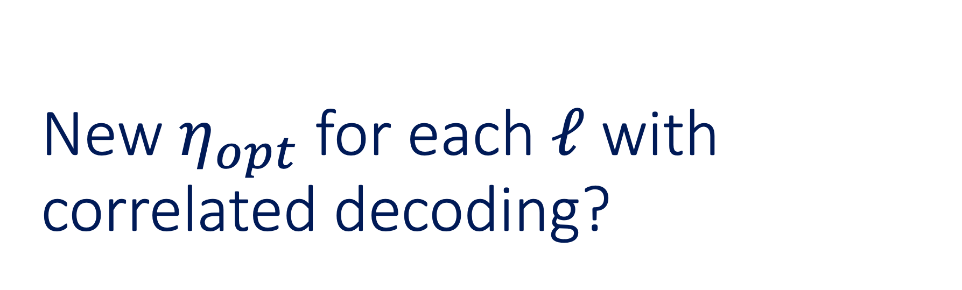
New $η_{opt}$ for each $ℓ$ with correlated decoding?

Slide 27
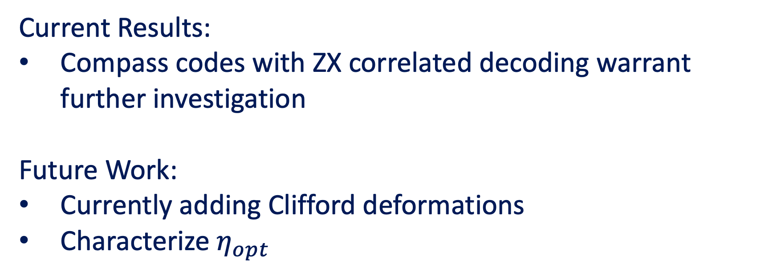
Key Takeaways…
Current Results:
Compass codes with ZX correlated decoding warrant further investigation
Future Work:
Currently adding Clifford deformations
Characterize $η_{opt}$

Slide 29
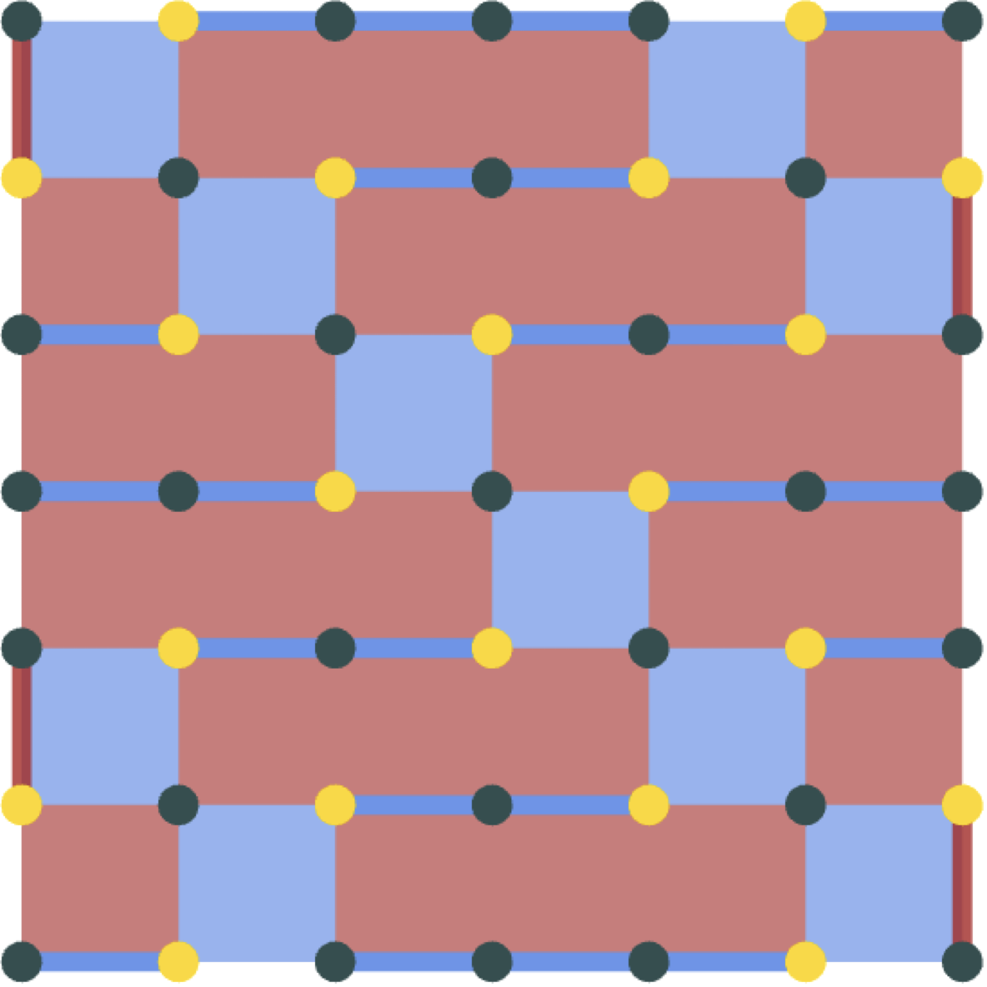
Adding Clifford deformations – the XZZX surface code
arxiv:2412.03808
Notes:
We may be having issues at higher noise biases because of the high weight Z stabilizers in the compass code. So, though we add information about the X errors using the correlated decoder through correlations, we may have reached a threshold where we can’t get much better than the current thresholds for high noise bias. We can add information missing from the high weight stabilizers by combining the XZZX surface code with the compass codes. This looks like applying a Hadamard on the weight 4 X stabilizers. These are the yellow dots. This way, we exchange a little information in the high weight Z stabilizers for information in the X stabilizers. This will also improve our decoder. The MWPM decoder for the XZZX surface code looks like the decoder for a repetition code, wrapped through the stabilizers. This pattern continues for the Clifford deformed compass codes. Since the repetition code performs optimally at infinite noise bias, we hope this will increase the thresholds at higher biases without losing too much information about Z errors for the correlated decoder.

Slide 30
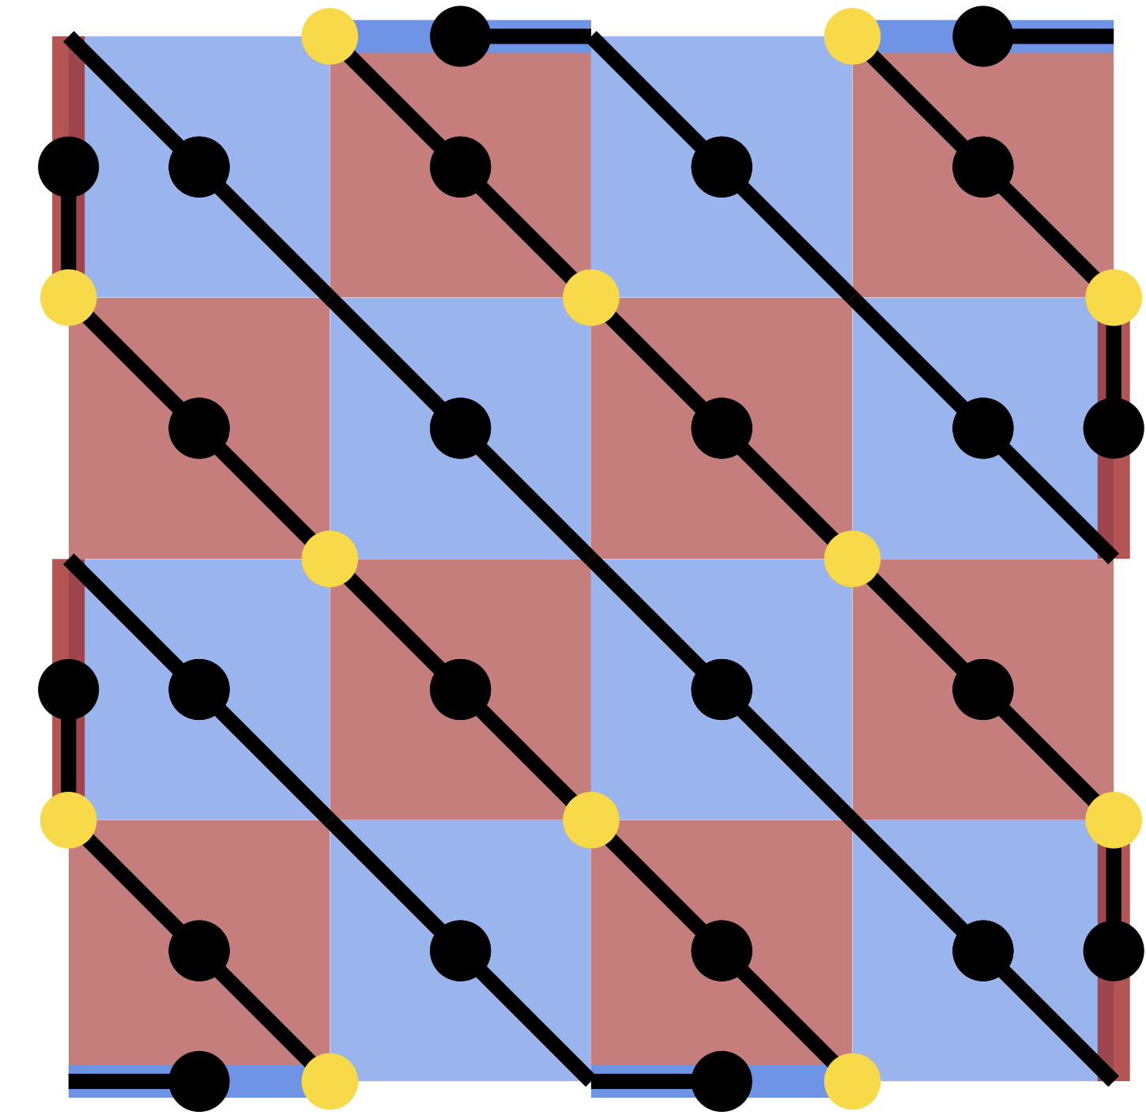
Adding clifford deformations – the XZZX surface code
arxiv:2412.03808
Notes:
We may be having issues at higher noise biases because of the high weight Z stabilizers in the compass code. So, though we add information about the X errors using the correlated decoder through correlations, we may have reached a threshold where we can’t get much better than the current thresholds for high noise bias. We can add information missing from the high weight stabilizers by combining the XZZX surface code with the compass codes. This looks like applying a Hadamard on the weight 4 X stabilizers. These are the yellow dots. This way, we exchange a little information in the high weight Z stabilizers for information in the X stabilizers. This will also improve our decoder. The MWPM decoder for the XZZX surface code looks like the decoder for a repetition code, wrapped through the stabilizers. This pattern continues for the Clifford deformed compass codes. Since the repetition code performs optimally at infinite noise bias, we hope this will increase the thresholds at higher biases without losing too much information about Z errors for the correlated decoder.

